Slide 1
Lines and area
Lines and area

Slide 2
Lines and zones
Note: This exercise requires Sales.xls of Excel Sources folder
First create those measures
Total Sales 2019 = CALCULATE(SUMX(FactSales,FactSales[SalesQuantity]*FactSales[UnitPrice]),DimDate[Year]=2019)
Total Cost 2019 = CALCULATE(SUMX(FactSales,FactSales[SalesQuantity]*FactSales[UnitCost]),DimDate[Year]=2019)

Slide 3
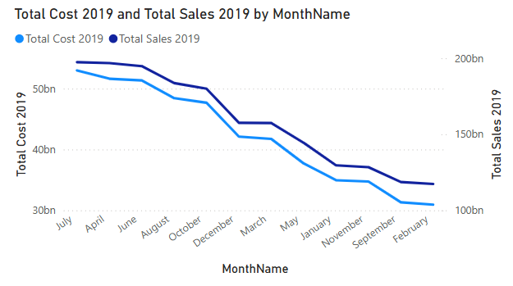
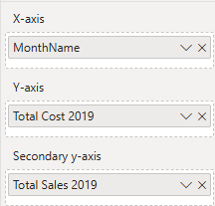
Lines and zones
And then add a Line chart visual to the scene and configure it

Slide 4
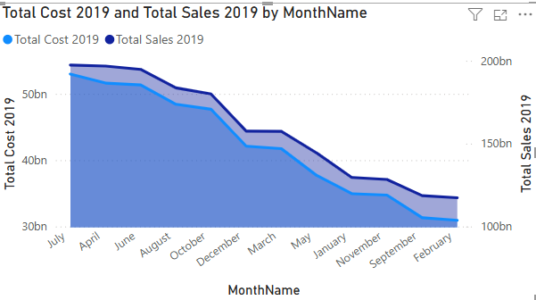
Lines and zones
Change the visualization to Area

Slide 5
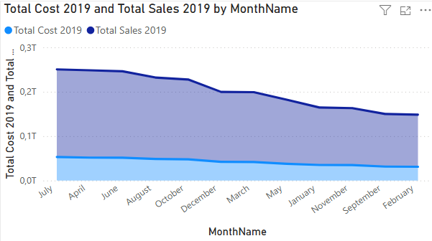
Lines and zones
Change the visualization to stacked Area

Slide 6
Lines and zones
To try to notice the difference between Surface and stacking Area

Slide 7
Lines and zones
Both are area charts that show how values change over a continuous axis (usually time), but they display categories differently.
Area Chart (Regular Area)
Shows only one measure at a time.
The area under the line is filled to emphasize the magnitude of a trend.
Stacked Area Chart
Breaks down the measure by a category (like Product, Channel, Region).
Each colored area shows a portion of the total.
Areas are stacked on top of each other, so the top line represents the cumulative total.

Slide 8
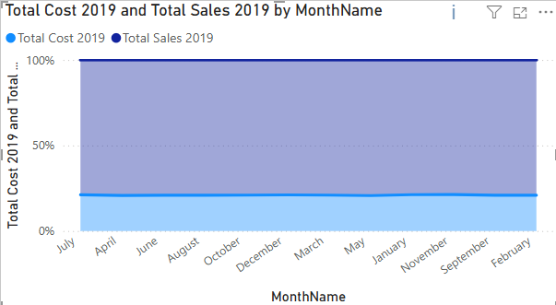
Lines and zones
Change the visualization to 100% Stacked Area

Slide 9
Thank you
Thank you

